Slide 1

WAY TO ENTERPRISE
AWS
VTI ACADEMY
Author: duy.nguyenngoc1@vti.com.vn

Slide 2
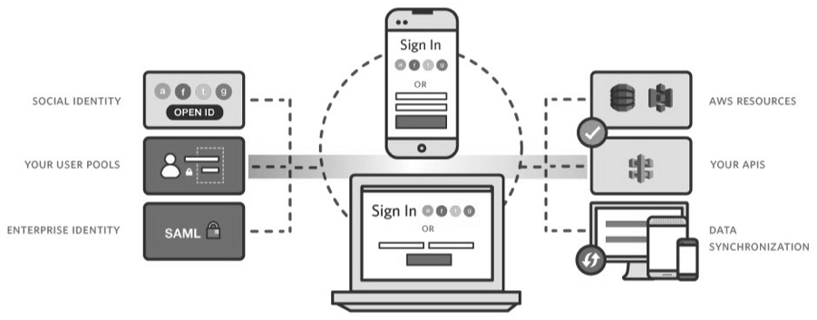
Cognito Service
A service that provides authentication, authorization, user management for web & mobile apps
Sign in via Username & Password, Facebook, Amazon, Google, Apple, …
Global Service, Serverless Service
Price: Free
Tutorial: https://docs.aws.amazon.com/cognito/latest/developerguide/what-is-amazon-cognito.html

Slide 3
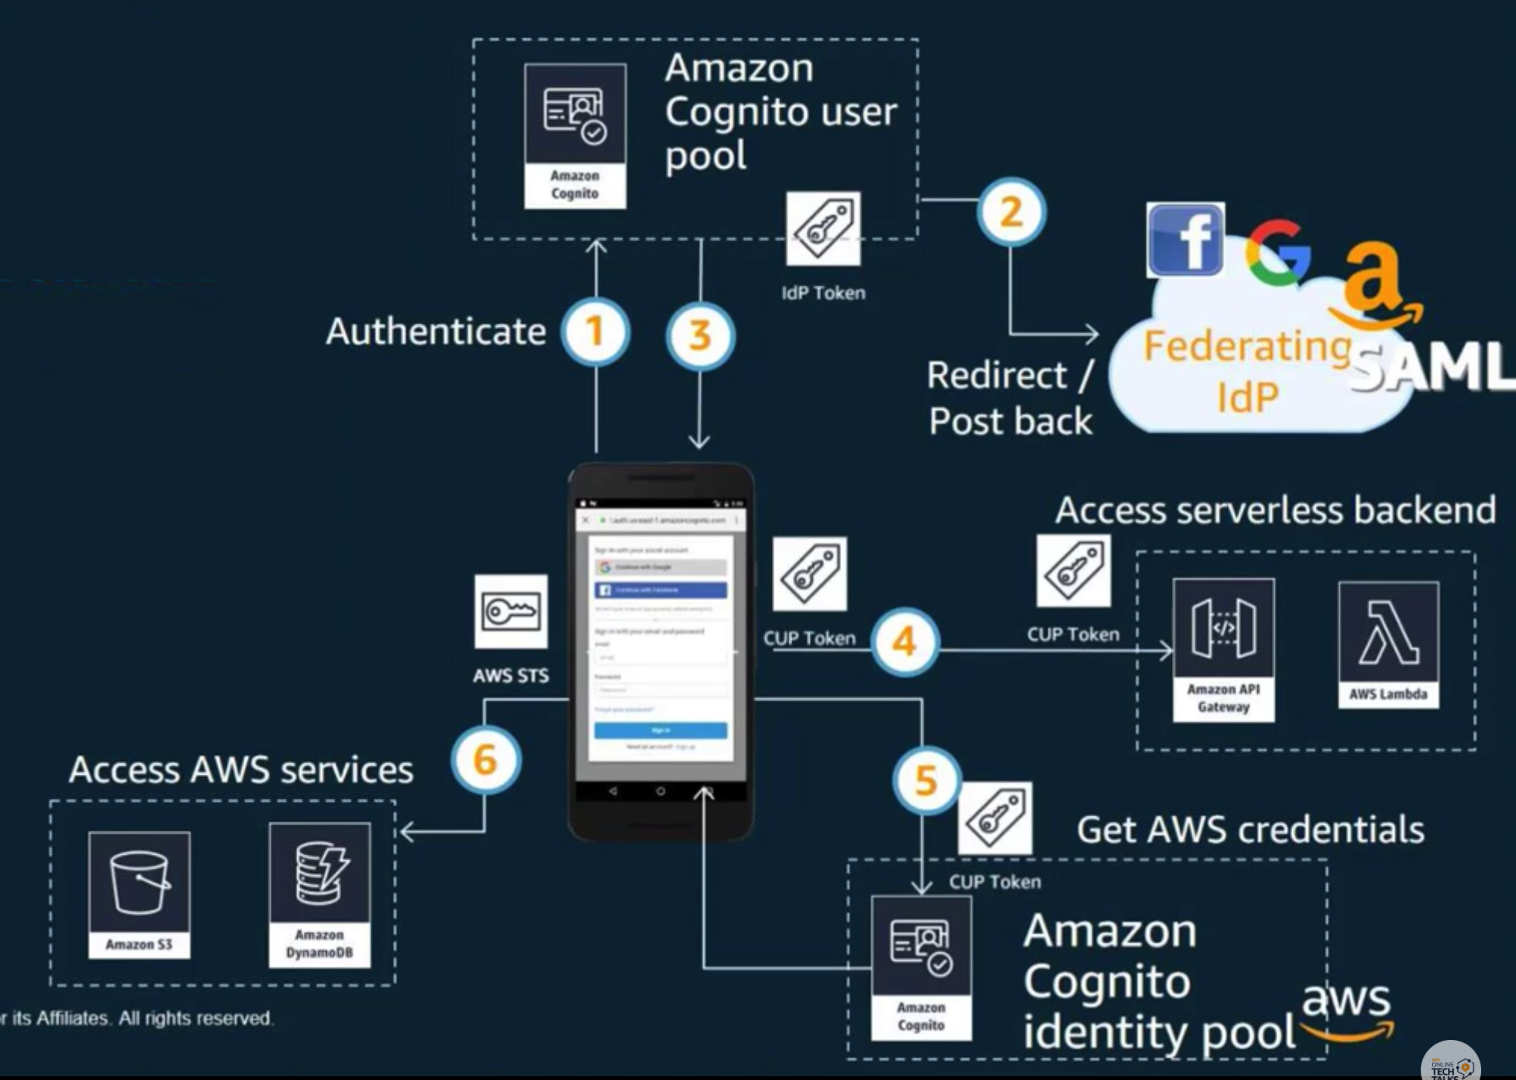
Cognito Service
Flow
User pool: for authentication
Identity pool: for authorization

Slide 4
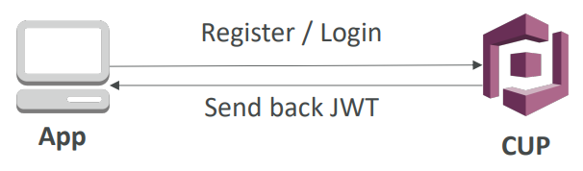
Cognito Service
Demo User Pool
Create User pool
View Hosted UI
Sign up with Username/Password
Sign in with Username/Password
Integrated login via Facebook
Sign in via Facebook

Slide 5
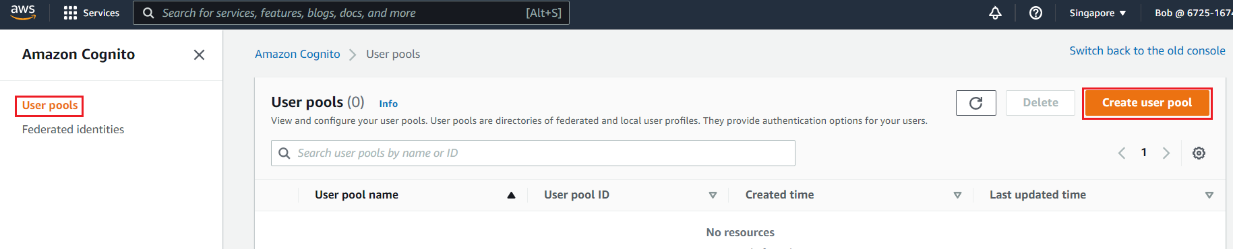
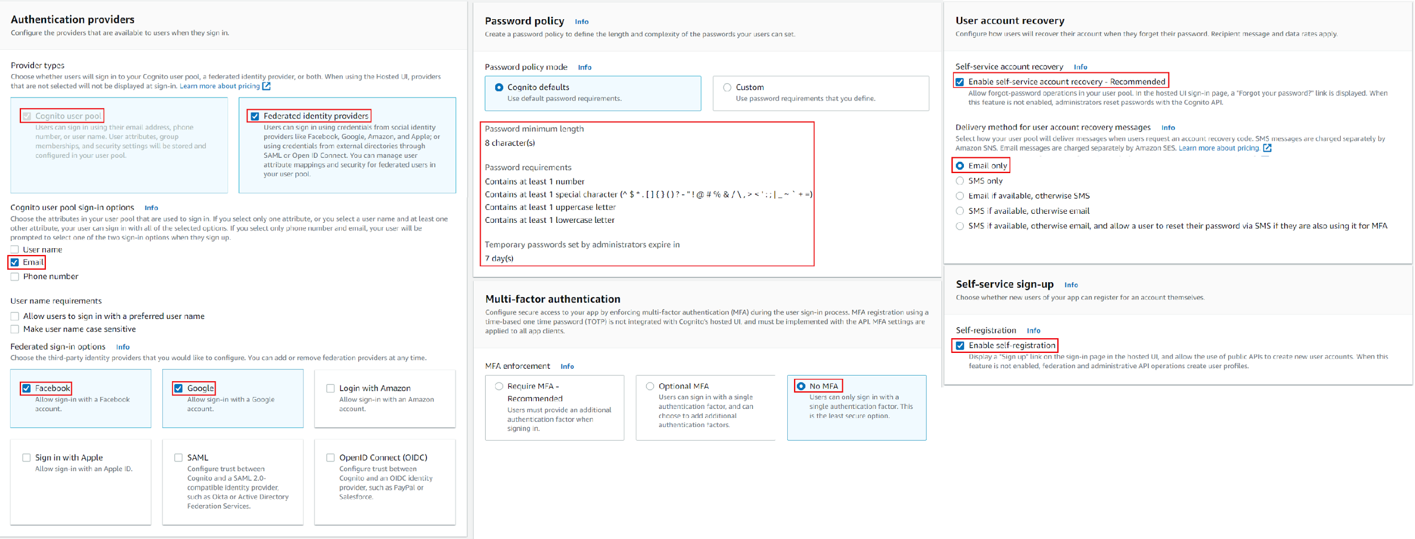
Cognito Service
Create User pool

Slide 6
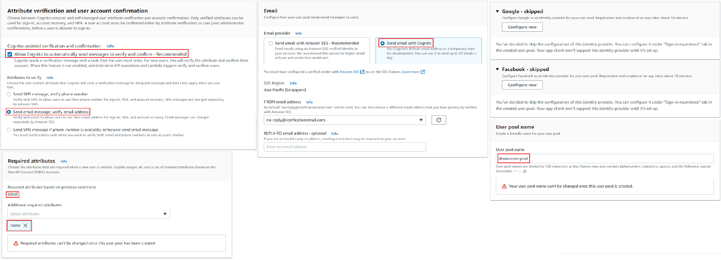
Cognito Service

Slide 7
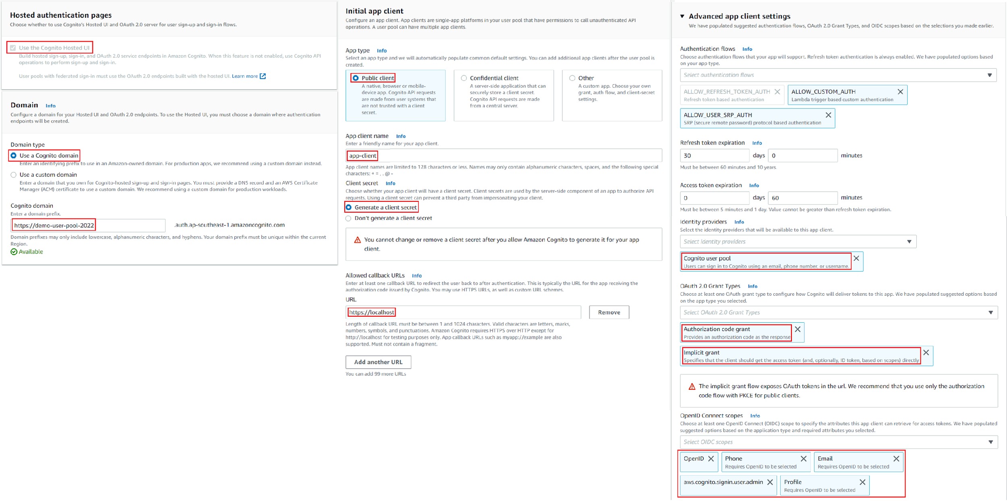
Cognito Service

Slide 8
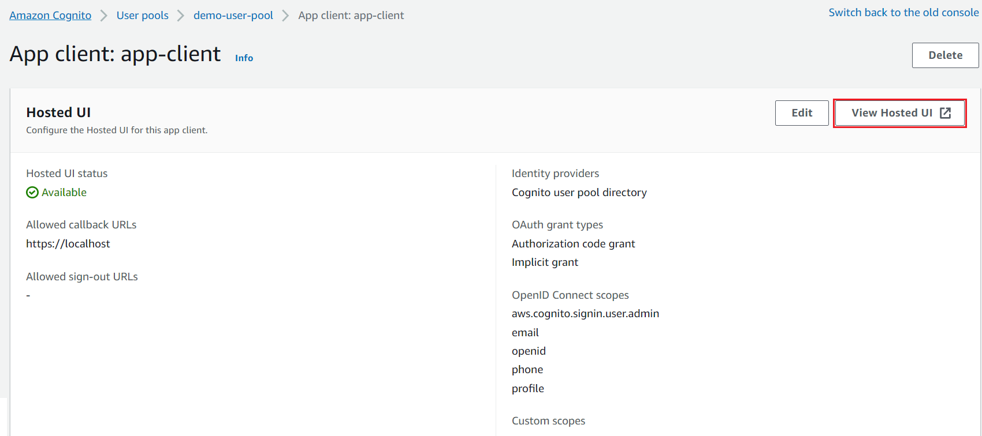
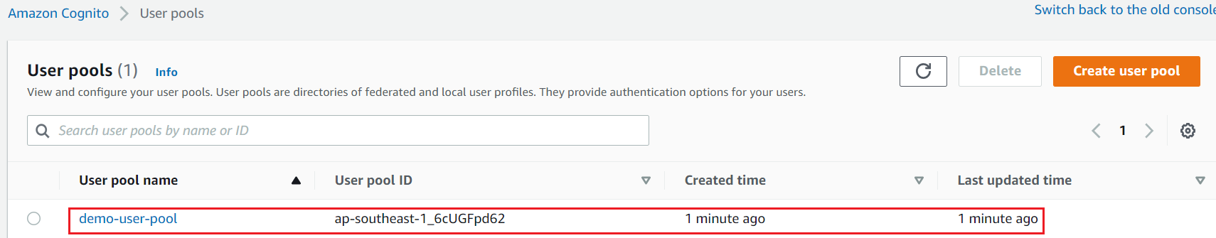
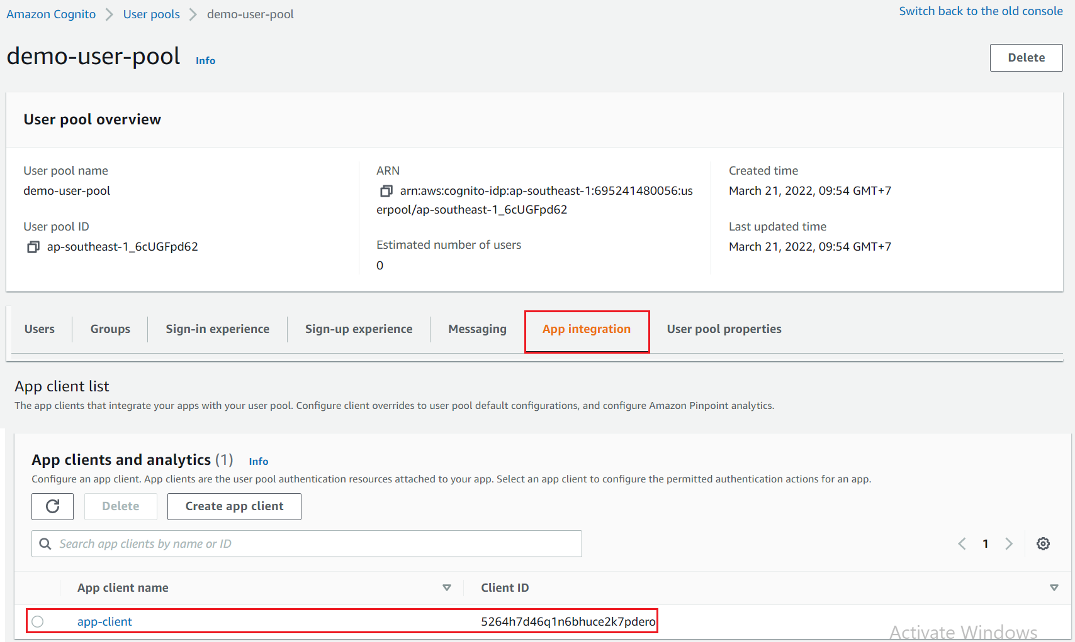
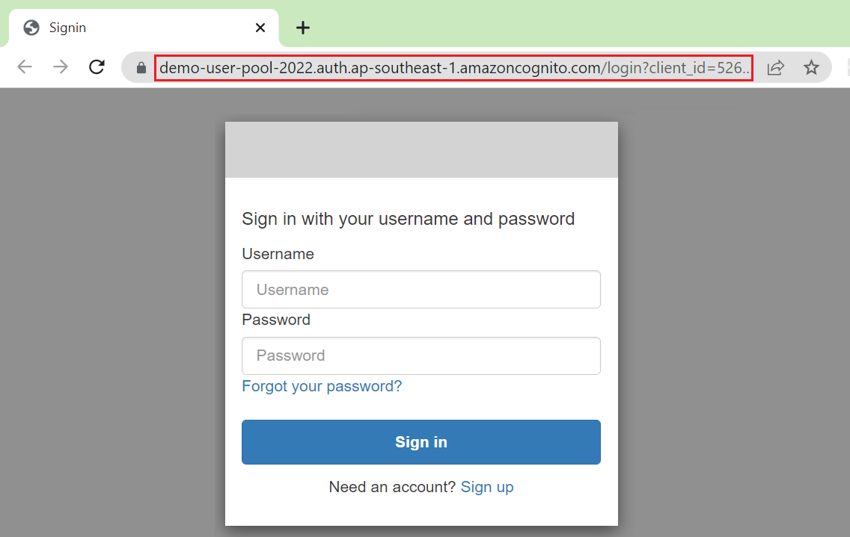
Cognito Service
View Hosted UI

Slide 9
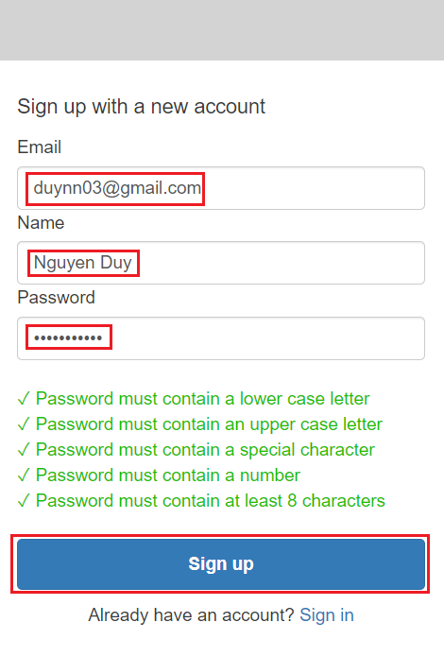
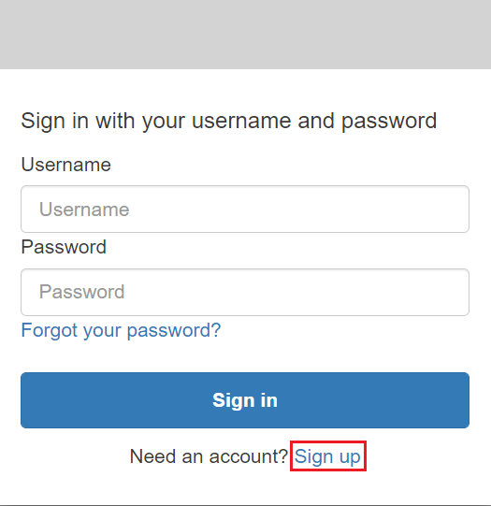
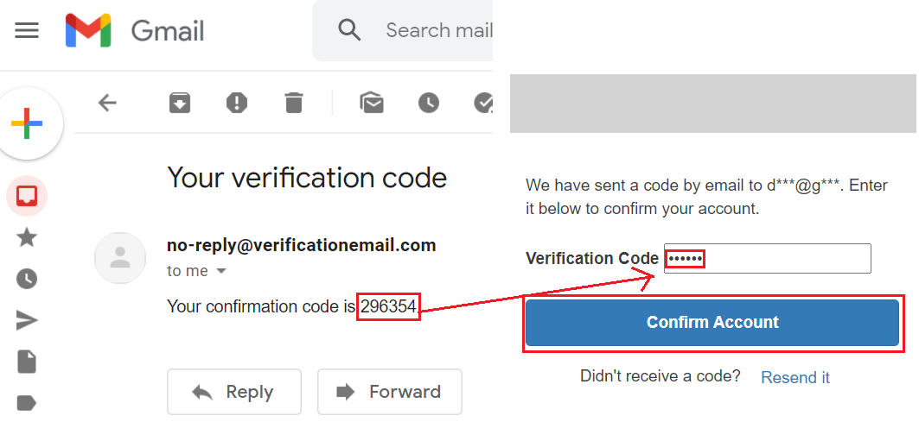
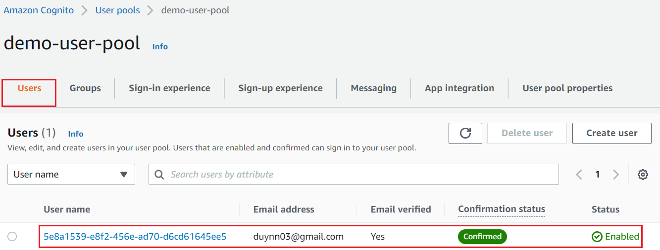
Cognito Service
Sign up with Username/Password

Slide 10
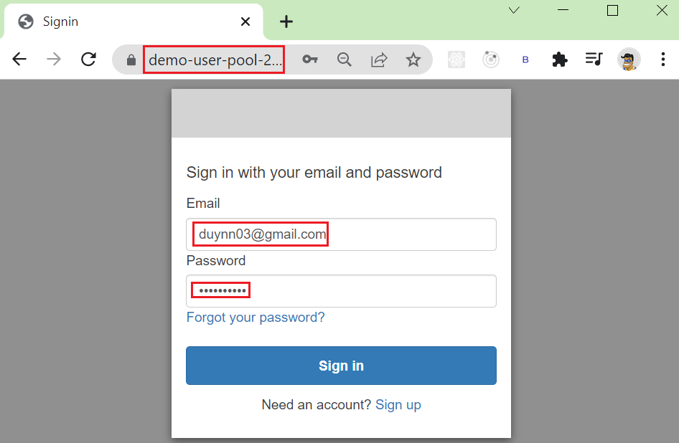
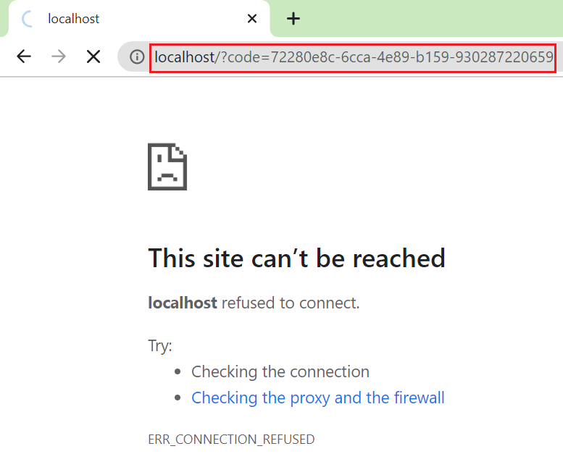
Cognito Service
Sign in with Username/Password
After login, Cognito will return code/token to get user’s information

Slide 11
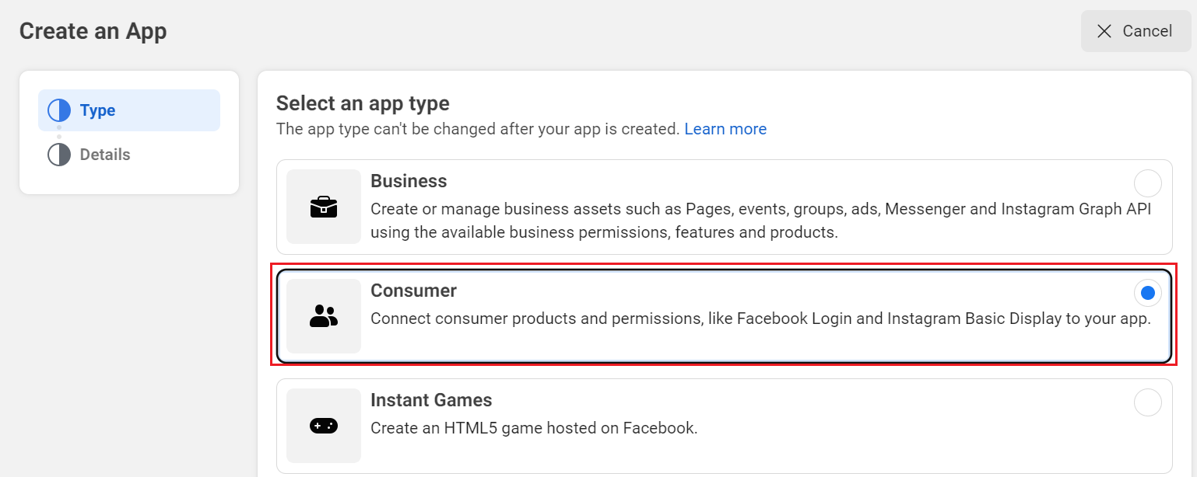
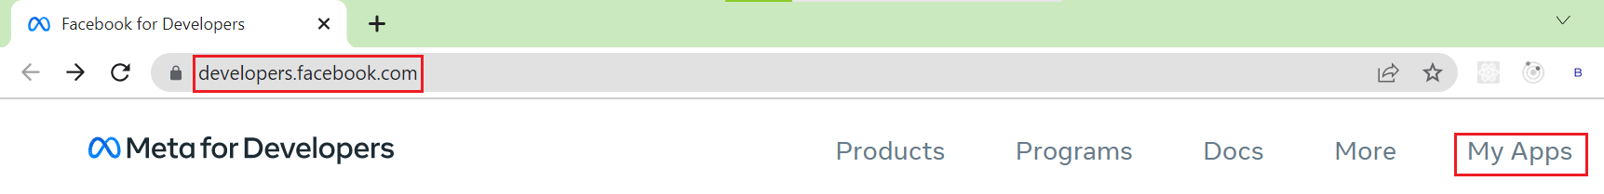
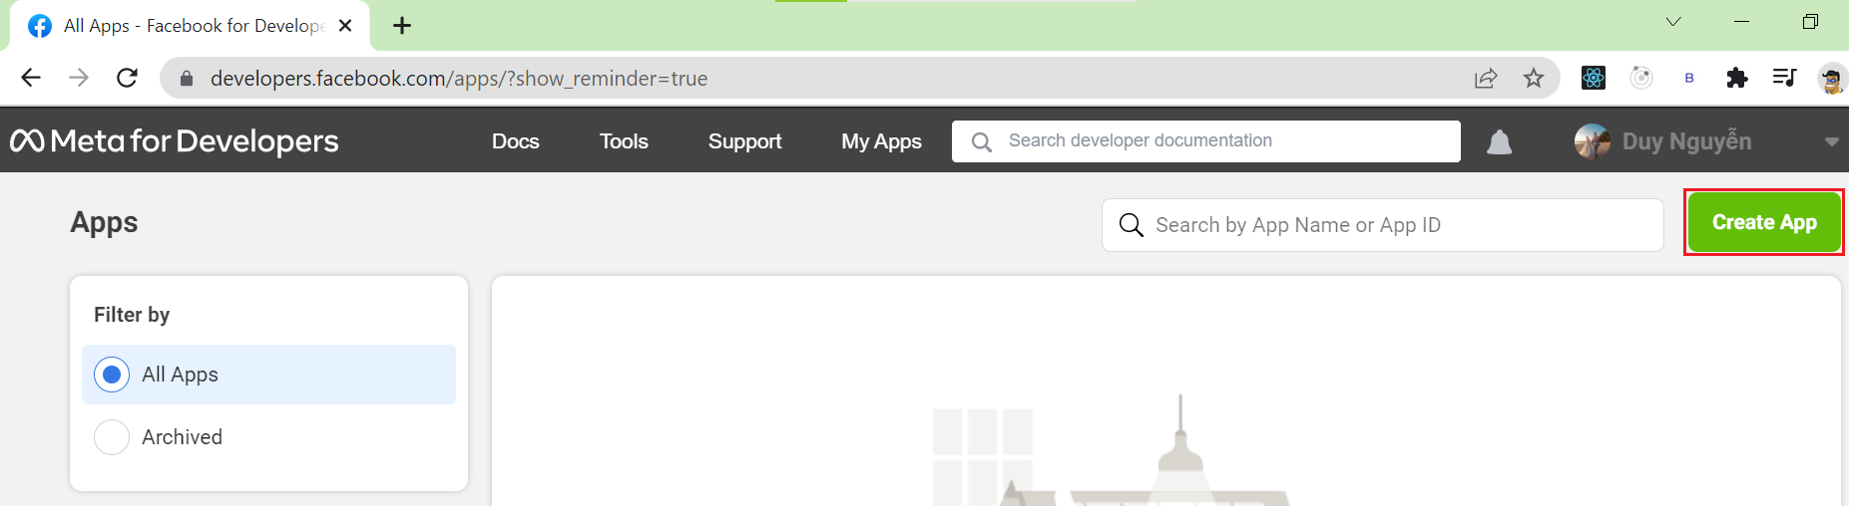
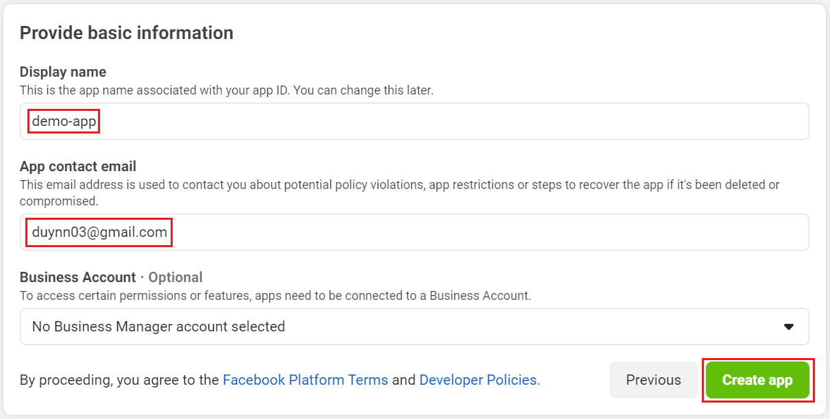
Cognito Service
Integrated login via Facebook
Register Facebook Application

Slide 12
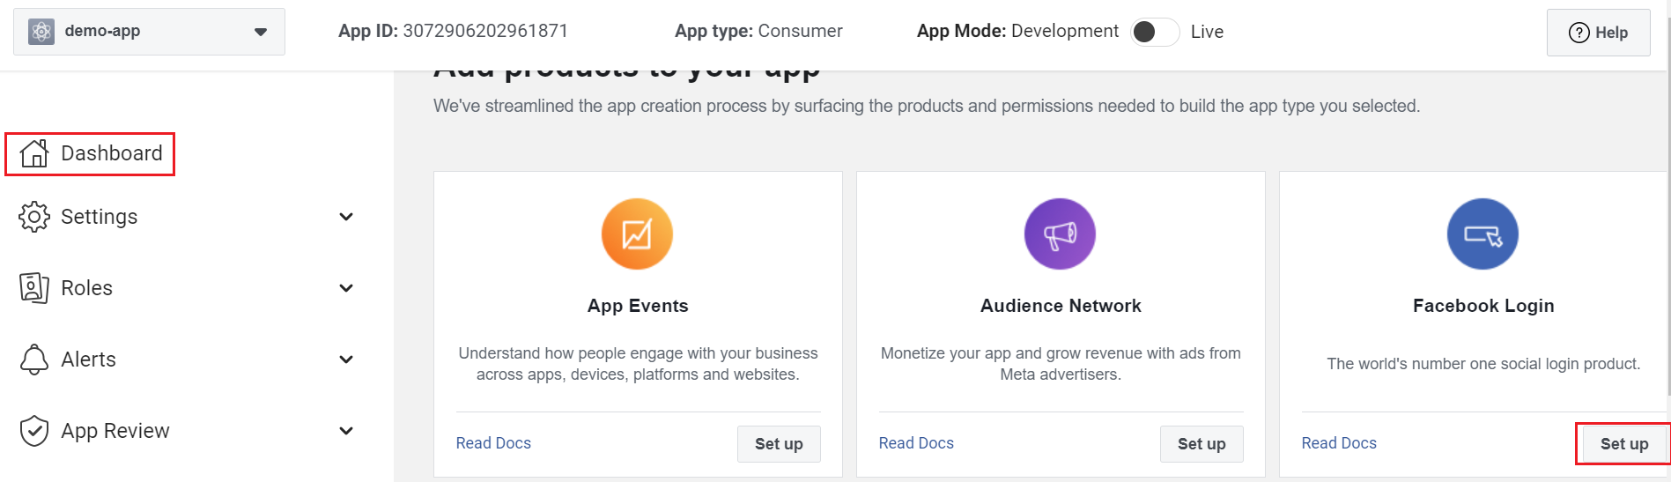
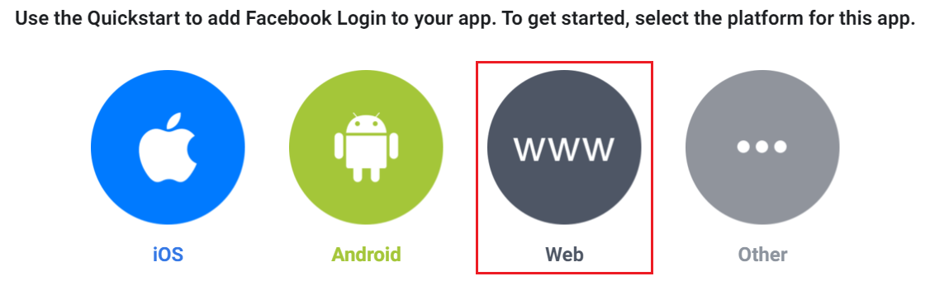
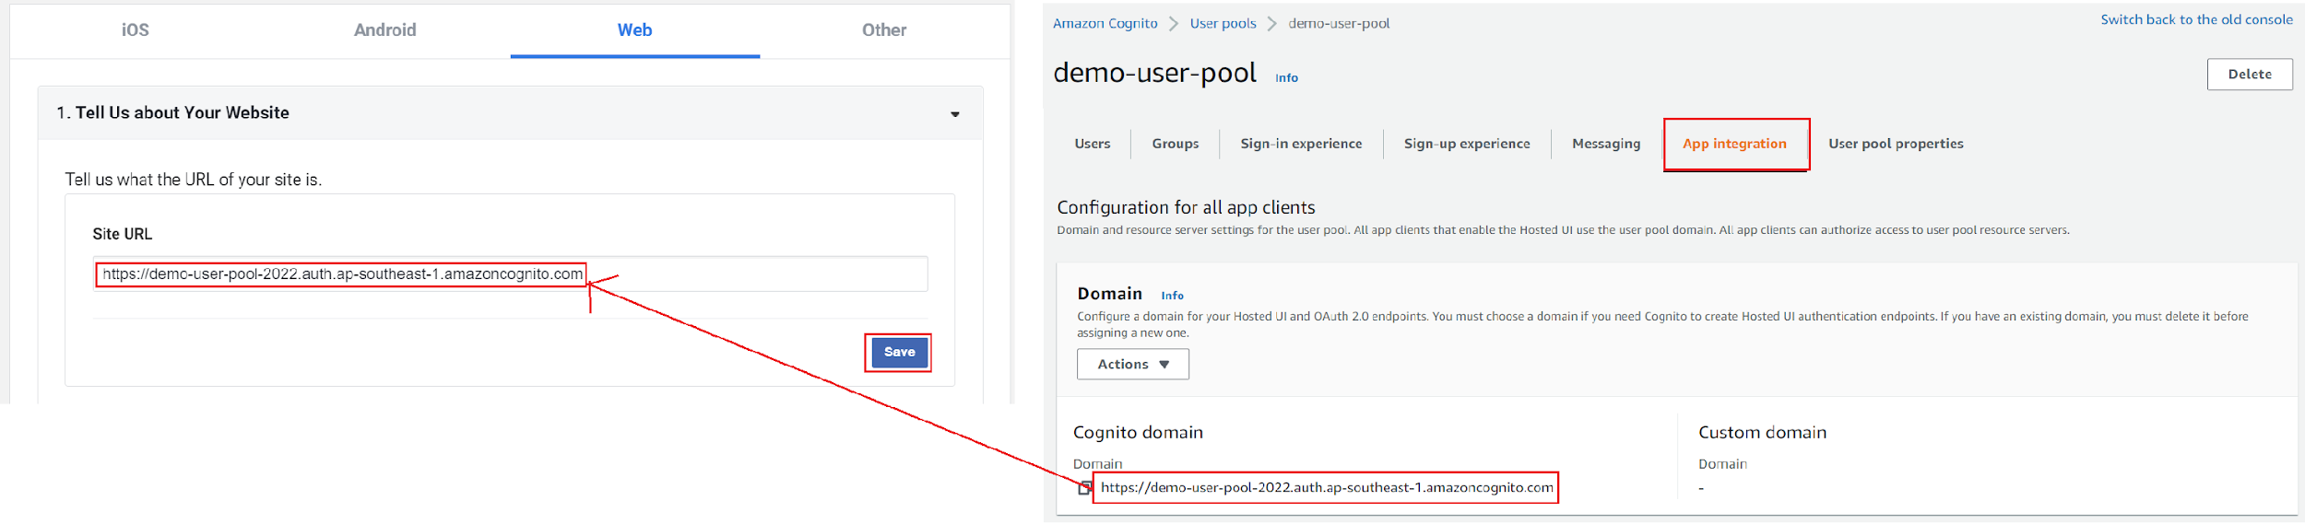
Cognito Service
Register Cognito Application to Facebook Application

Slide 13
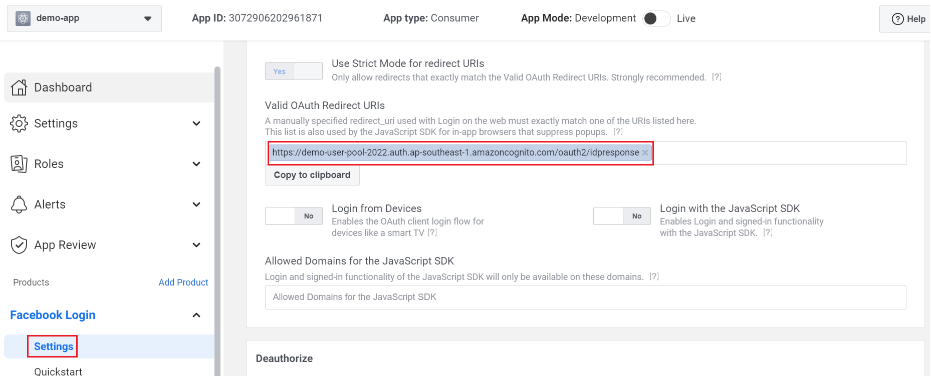
Cognito Service
https://YOUR_DOMAIN/oauth2/idpresponse

Slide 14
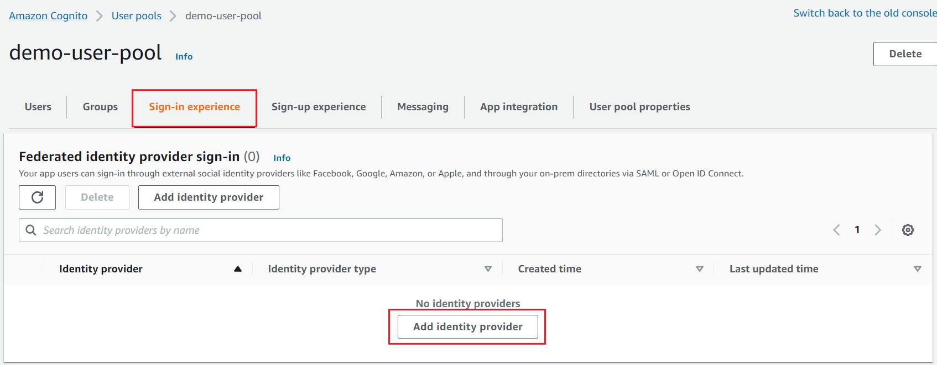
Cognito Service
Register Facebook Application to Cognito Application

Slide 15
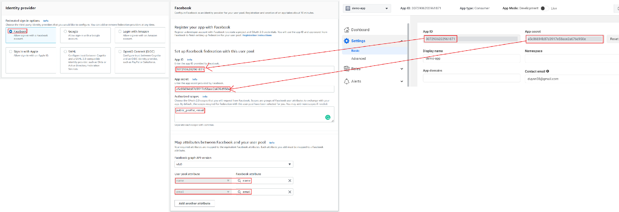
Cognito Service

Slide 16
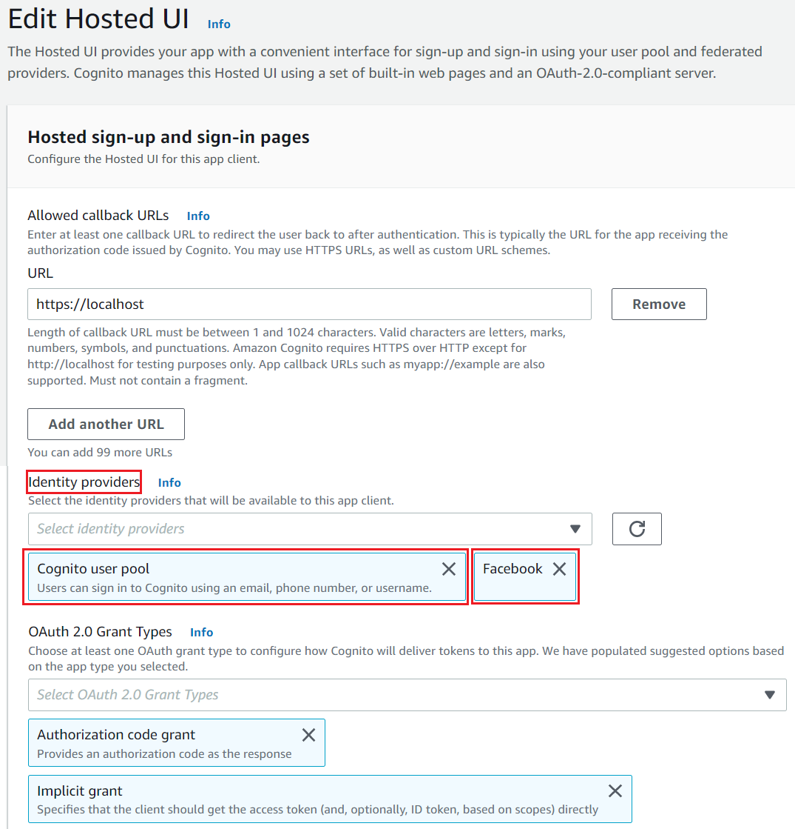
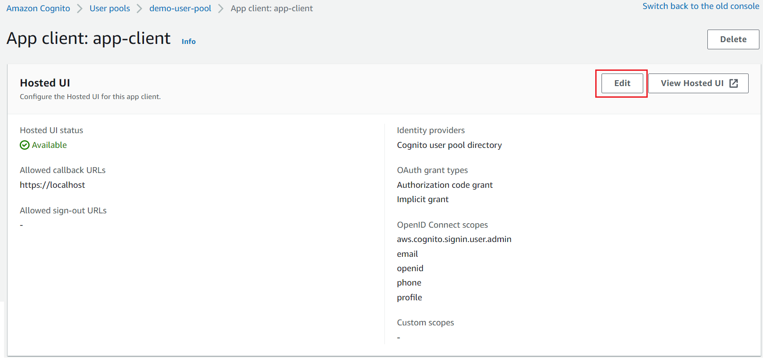
Cognito Service
Edit User pool

Slide 17
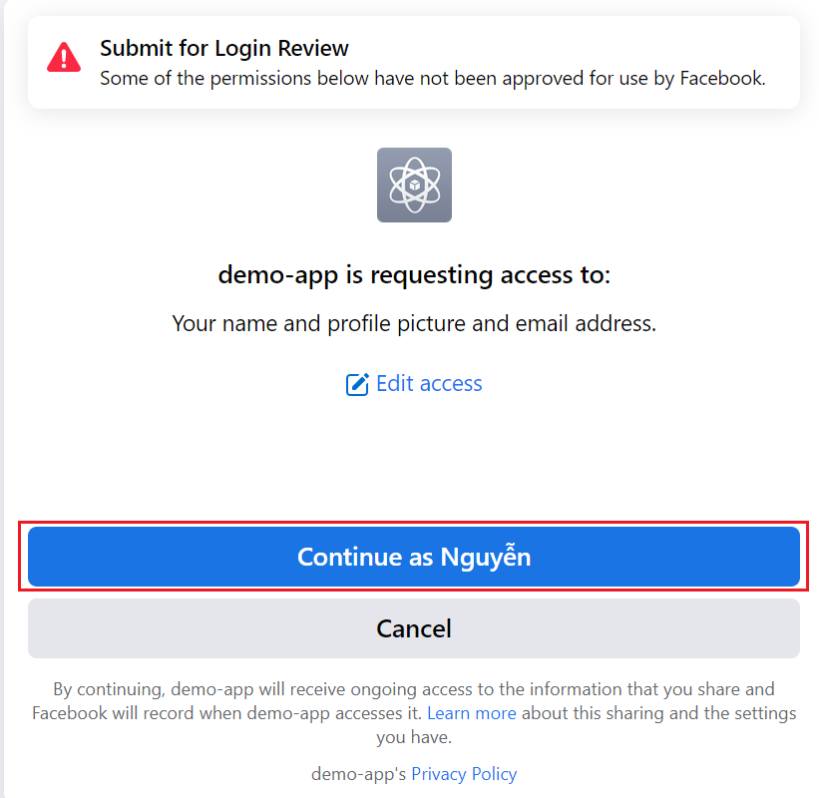
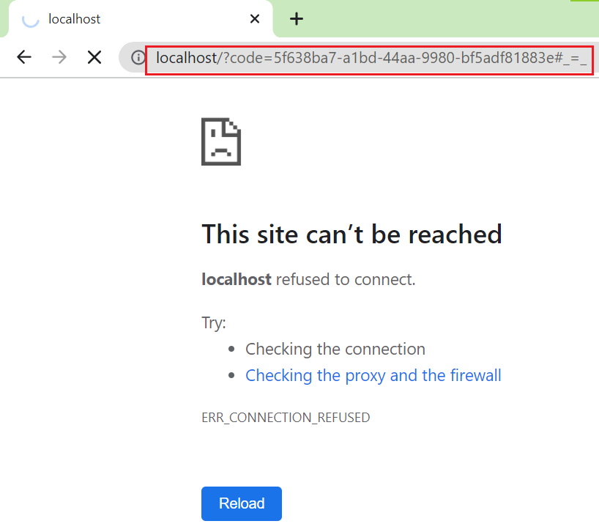
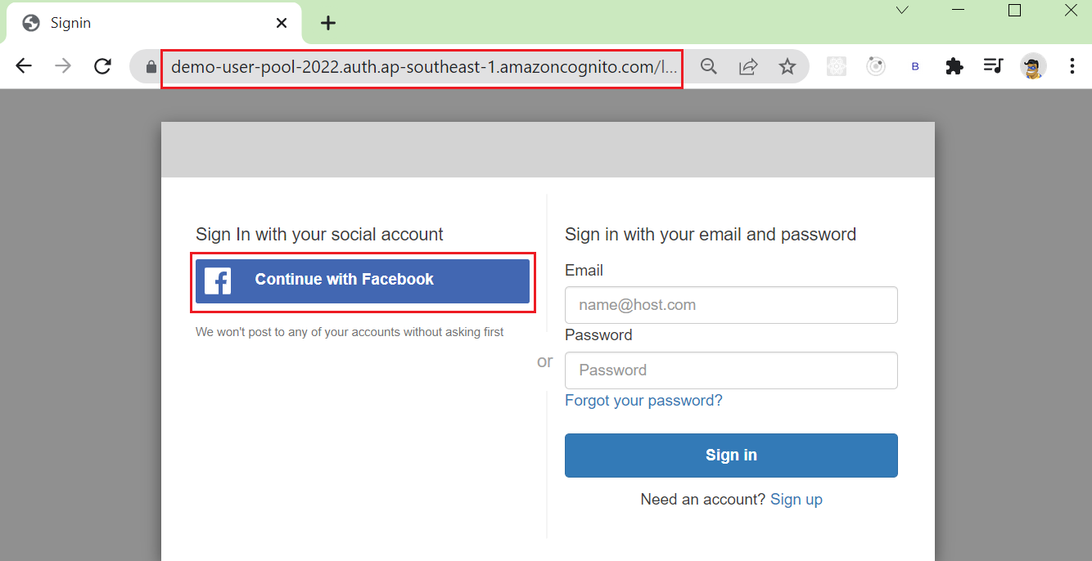
Cognito Service
Sign in via Facebook

Slide 18
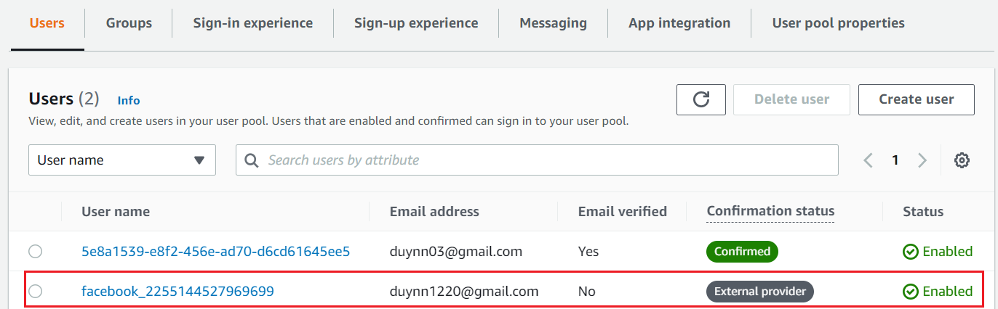
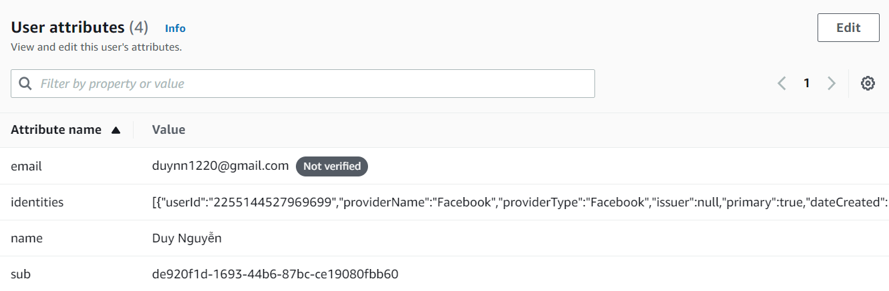
Cognito Service
https://www.youtube.com/watch?v=BN3SBeqaq0g

Slide 19
Cognito Service
Other Demo
Integrated login via Gmail: https://www.youtube.com/watch?v=r1P_glQGvfo
SAML provider: https://www.youtube.com/watch?v=NVKUQctvpUE
Integrated with my app (Using SDK): https://www.youtube.com/watch?v=jTu--LpjA18

Slide 20
Assignment
Self-practice

Slide 21
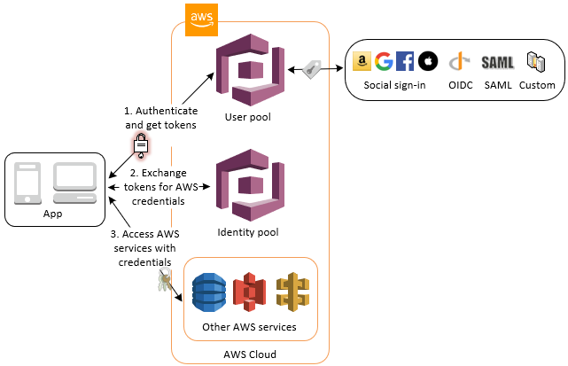
Cognito Service
Components
User pool
Identity pool
Cognito Sync
Monitoring

Slide 22
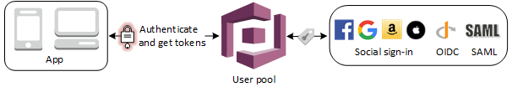
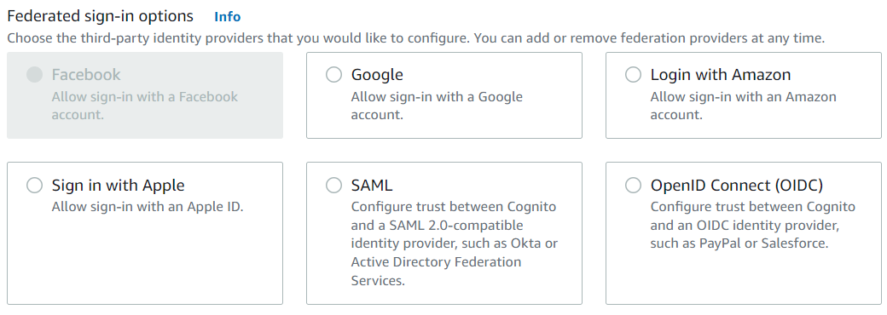
Cognito Service
User pool
Is user directory, serverless database of user
Using for Authentication
User login with
Username/Email/Phone number & Password via User Pool (UI/SDK)
Social identity provider: Facebook, Google, Amazon, Apple, ...
Federate identity provider: SAML, OpenID Connect (OIDC)
Components: User, Group, Application

Slide 23
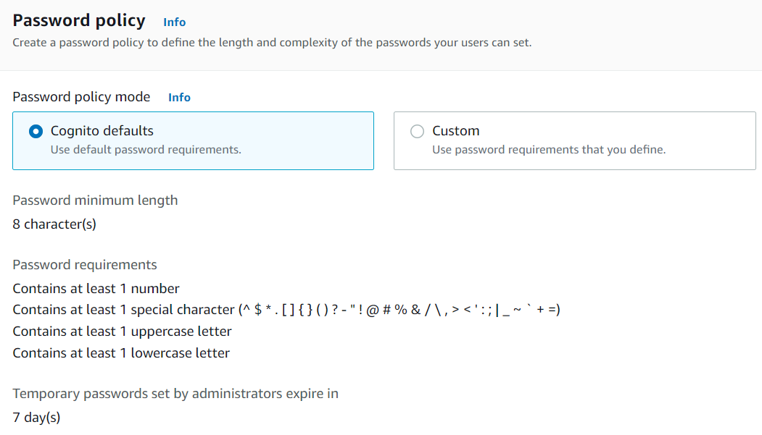
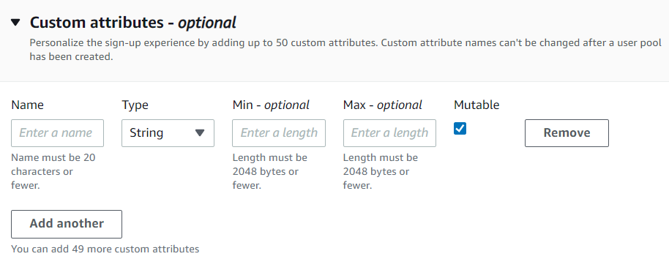
Cognito Service
User information
Username/Email/Phone number & Password
Basic information: name, gender, ..., custom attribute
Group
Manage User by group
Manage permission, role, ...
Password policy
Custom attribute

Slide 24
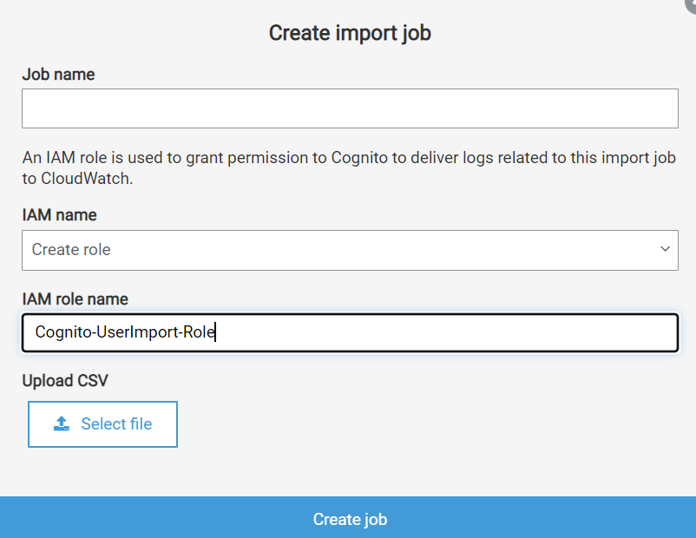
Cognito Service
Features
Password policy, MFA, Recover account
Sign in, Sign up, Forgot password, Remember me
Disable account
Import User from external (Ex: file json, csv, ...), support Lambda trigger
Messaging
Support code/link
2 provider: AWS Cognito, Amazon SES (recommended - send unlimited mail)
Import User

Slide 25
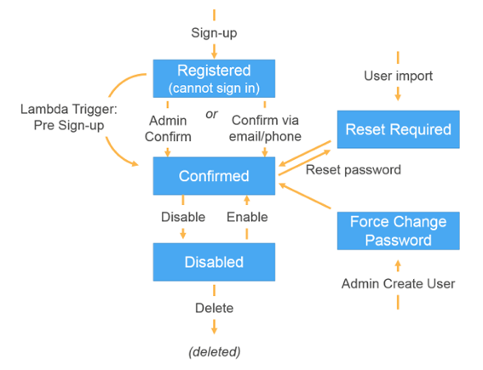
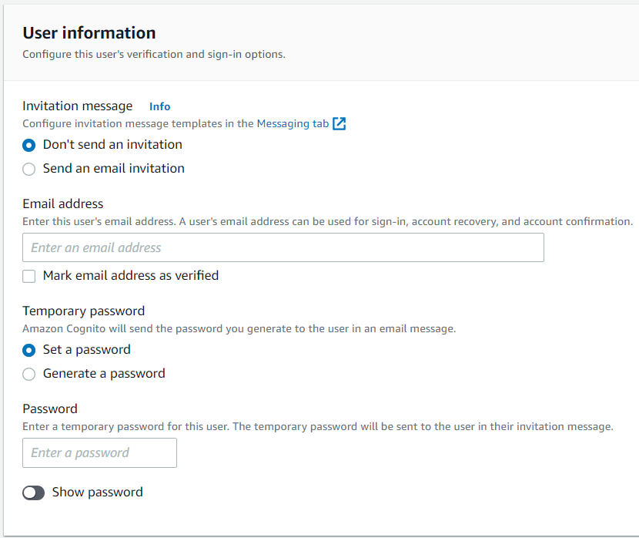
Cognito Service
Self-registration
User registers his own account / Admin register account for user
Verified via email, phone number
User registers his own account
Admin register account for user

Slide 26
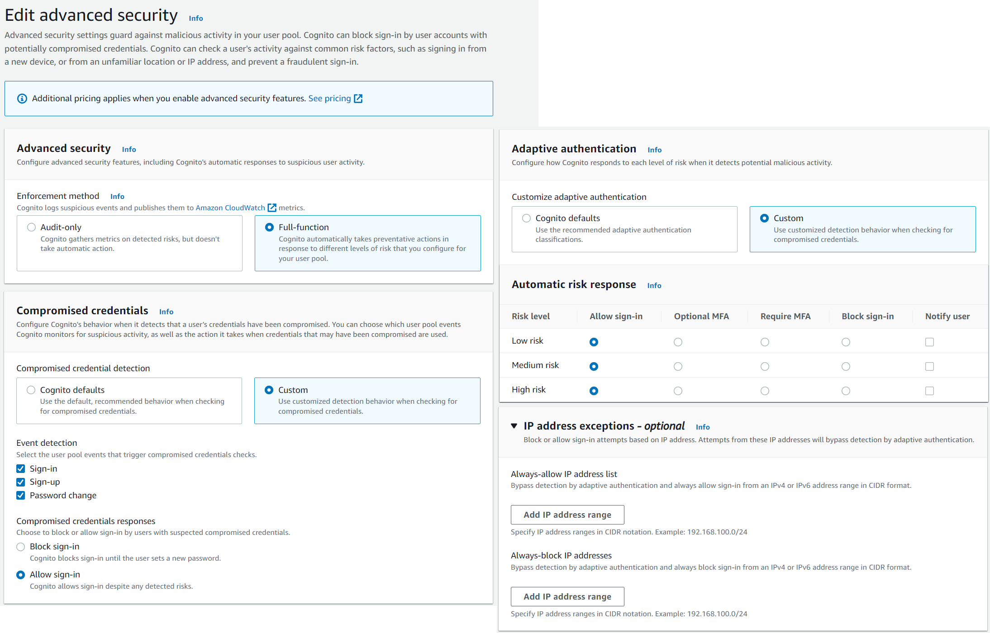
Cognito Service
Security
Detecting abnormal login information (Ex: different IP, wrong input many times, ...)
Charged fee

Slide 27
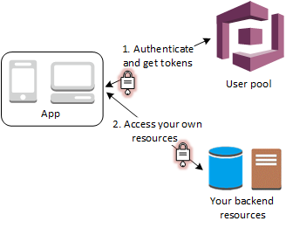
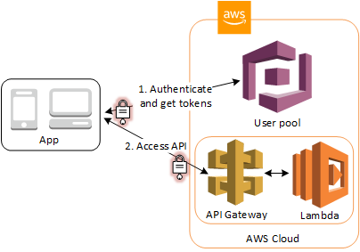
Cognito Service
After logging in, users can access
AWS Service via Identity Pool
Application via code/token
API Gateway & Lambda via Role
Accessing AWS Service
Accessing Application
Accessing API Gateway & Lambda Function

Slide 28
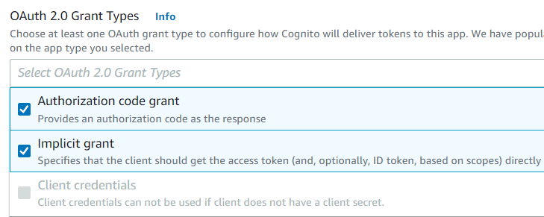
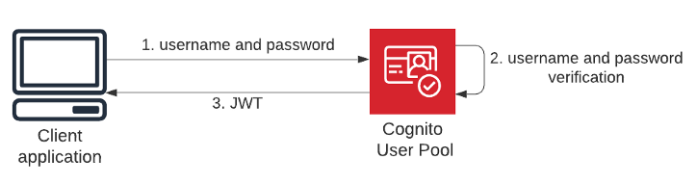
Cognito Service
Application
OAUTH2: After successful login, grant Access Token / authorization code to access to the application via callbackURL
Implicit: providing token, TTL
Authorization code: providing code, using for request token
Client Credential: Using for machine-to-machine communication

Slide 29
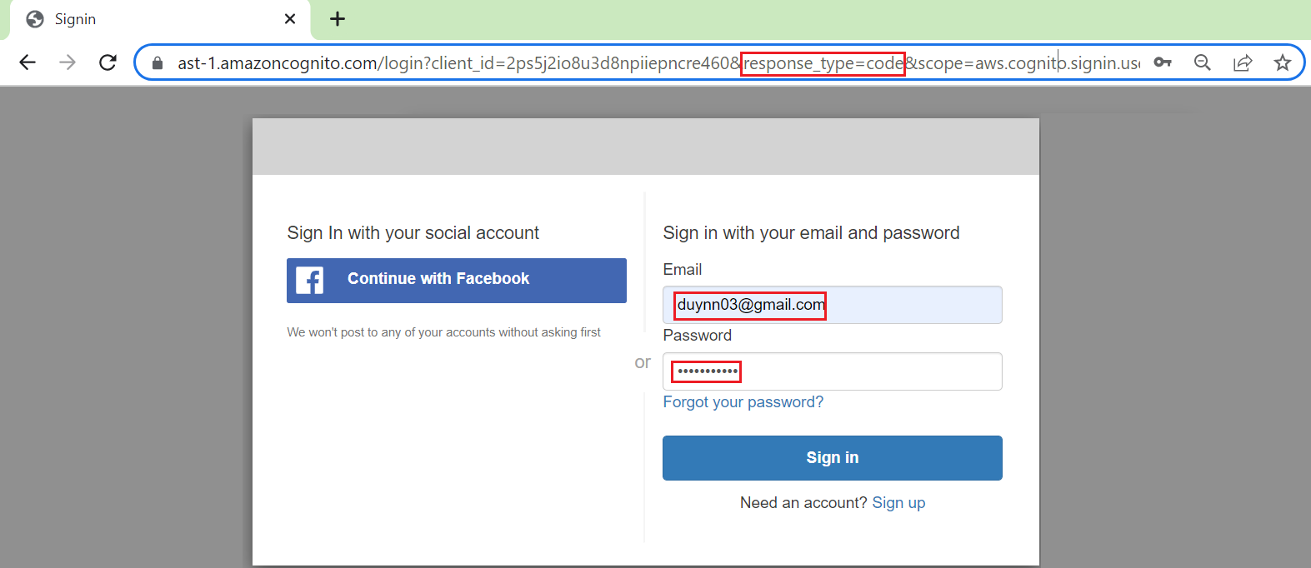
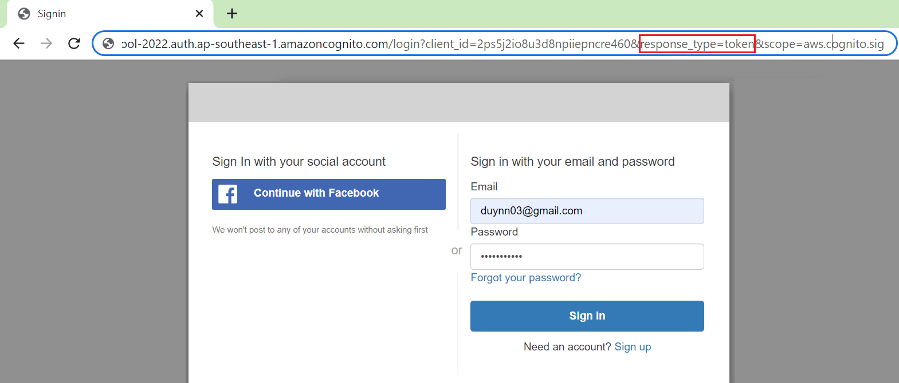
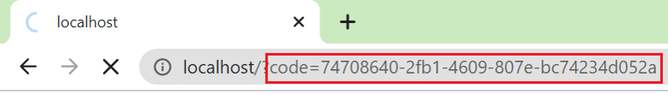

Cognito Service
Authorization code
Token
https://your_domain/login?client_id=your_app_client_id&response_type=Code&scope=your_scope&redirect_uri=your_callback_url
https://your_domain/login?client_id=your_app_client_id&response_type=token&scope=your_scope&redirect_uri=your_callback_url

Slide 30


Cognito Service
You can set data into token:
Config:
Token, Refresh Token, TTL, …
Callback URLs, Sign-out URLs
Mapping attribute
Domain
Customize page sign up & sign-in page
Trigger Lambda Function (Next Lesson)
...
Data in token
Application information

Slide 31
Cognito Service
Support login via UI Page / SDK
Login via SDK tutorial: https://www.youtube.com/watch?v=jTu--LpjA18

Slide 32
Assignment
Self-practice

Slide 33

Cognito Service
Identity pool (Federated Identity)
Provide credential & config role so that User can access AWS Services
Using for Authorization
Support
Unauthenticated identity (Guest User)
Authenticated identity (User Pool: Username & Password, Facebook, Google, … User)
The application sends the user's token to the Identity pool to get the User's Role and the credential allowing the User to access the AWS Service

Slide 34

Cognito Service
Demo Identity Pool
Create Identity pool
Set permissions
Test

Slide 35


Cognito Service
Create Identity pool

Slide 36


Cognito Service
Set permissions
Default permissions

Slide 37




Cognito Service
Authenticated Role
Unauthenticated Role
Edit permissions

Slide 38


Cognito Service
Test
Unauthenticated user (Guest)
X-AMZ-TARGET: com.amazonaws.cognito.identity.model.AWSCognitoIdentityService.GetId
Content-Type: application/x-amz-json-1.1
https://docs.aws.amazon.com/cognitoidentity/latest/APIReference/API_GetId.html
Get AWS Credential

Slide 39


Cognito Service
Create S3 Bucket & Files
X-AMZ-TARGET: com.amazonaws.cognito.identity.model.AWSCognitoIdentityService.GetCredentialsForIdentity
Content-Type: application/x-amz-json-1.1
https://docs.aws.amazon.com/cognitoidentity/latest/APIReference/API_GetCredentialsForIdentity.html

Slide 40


Cognito Service

Slide 41

Cognito Service
Authenticated user
Get JWT Token

Slide 42



Cognito Service

Slide 43


Cognito Service
X-AMZ-TARGET: com.amazonaws.cognito.identity.model.AWSCognitoIdentityService.GetId
Content-Type: application/x-amz-json-1.1
Get AWS Credential

Slide 44

Cognito Service
Tutorial: https://www.youtube.com/watch?v=tAUmz94O2Qo

Slide 45
Assignment
Self-practice

Slide 46
Cognito Service
Cognito Sync
Synchronize data from device to Cognito
Deprecated and replaced by AppSync
Monitoring
CloudWatch
CloudTrail
Cognito User Reporting

Slide 47
Summary
A service that provides authentication, authorization, user management for web & mobile apps
Sign in via Username & Password, Facebook, Amazon, Google, Apple, …
Global Service, Serverless Service, Price: Free
Components
User pool
Is user directory, using for Authentication
User login with Username & Password, Social network, … via User Pool (UI/SDK)
Features: Password policy, MFA, Recover account, Sign in, Sign up, Forgot password, Remember me, Disable account, Import User,, Messaging, Self-registration, Detecting abnormal login information, Lambda trigger, …

Slide 48
Summary
Identity pool
Provide credential & role to user can access AWS Services
Using for Authorization
Support: Unauthenticated identity, Authenticated identity
Monitoring: CloudWatch, CloudTrail, Cognito User Reporting

Slide 49
Q & A
Copyright © VTI Academy All Rights Reserved

